Slide 1

A CD of this message will be available (free of charge) immediately following today's message
This message will be available via podcast later this week at calvaryokc.com
2 Samuel
05-06

Slide 2
2 Samuel
05-06
1 Kings 12:16 ~ … What share have we in David? We have no inheritance in the son of Jesse. To your tents, O Israel! Now, see to your own house, O David!

Slide 3
2 Samuel
05-06

Slide 4
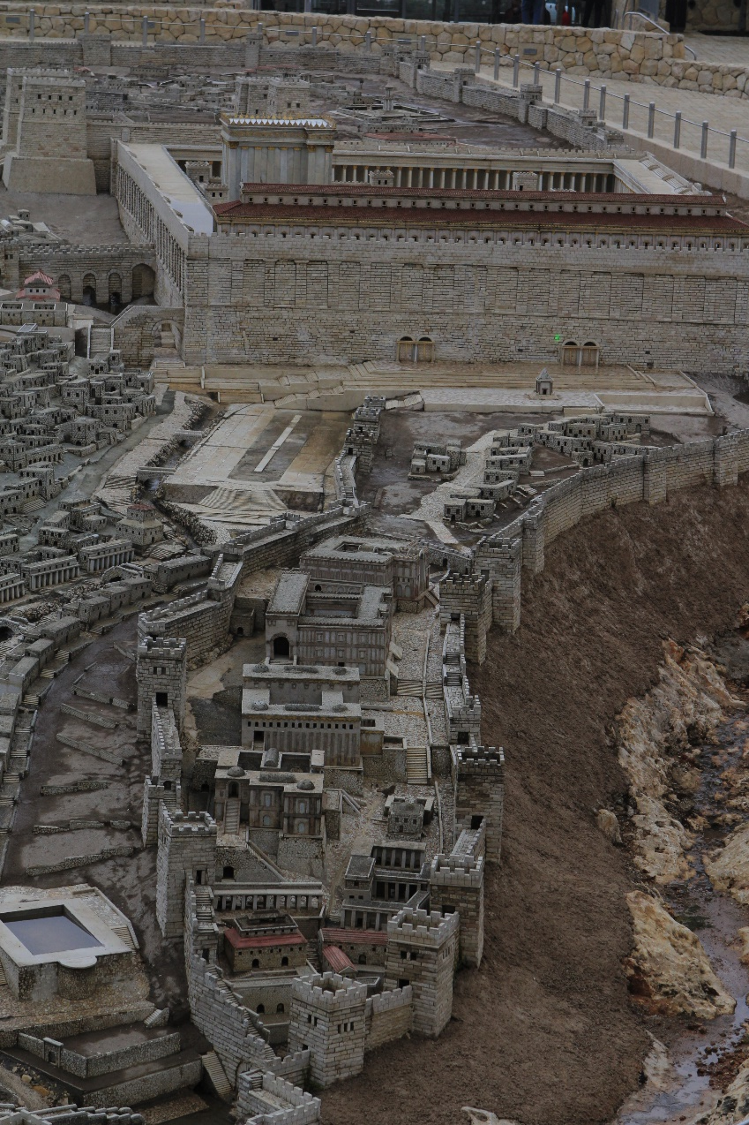
2 Samuel
05-06
Water shaft ~ NIV, grappling hook
Warren’s Shaft
Gihon Spring

Slide 5
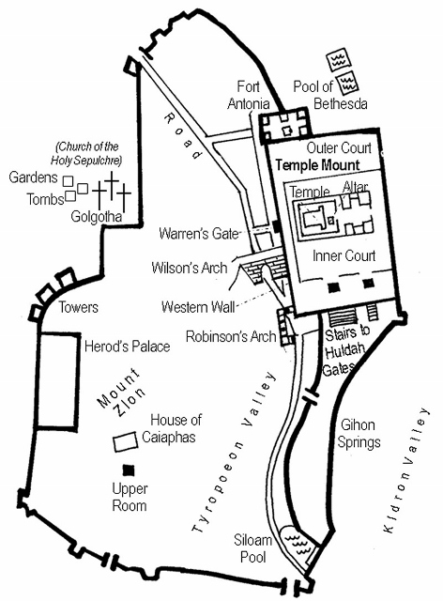
2 Samuel
05-06
Pools of Bethesda
Jerusalem in Jesus’ Day
Siloam Sprigs

Slide 6
2 Samuel
05-06

Slide 7
2 Samuel
05-06
Millo ~ rampart or mound
NIV ~ supporting terraces

Slide 8
2 Samuel
05-06

Slide 9
2 Samuel
05-06
Deut. 17:17 ~ Neither shall he multiply wives for himself, lest his heart turn away; nor shall he greatly multiply silver and gold for himself.

Slide 10
2 Samuel
05-06

Slide 11
2 Samuel
05-06
Circle around ~ KJV, fetch a compass

Slide 12
2 Samuel
05-06

Slide 13
2 Samuel
05-06
Alan Redpath ~ "We want God's presence very much, don't we? But we like to hitch His presence to some of our new carts. We like to add Him to our list of organizations, to load Him on top of the mechanics of a busy life, and then drive. How much of our service is really in the energy of the flesh, I wonder! So often we put forth our hands, but not our hearts."

Slide 14
2 Samuel
05-06

Slide 15
2 Samuel
05-06
Sons of Korah challenging Moses ~ Num. 16
Beginning of the Mosaic Covenant (civil)
Nadab and Abihu offered profane fire ~ Lev. 10
Beginning of the Levitical Covenant (spiritual)
Uzzah and the ox cart ~ 2 Sam. 6
Beginning of the David Covenant
Ananias and Sapphira ~ Acts 5
Beginning of the New Covenant

Slide 16
2 Samuel
05-06

